Slide 1
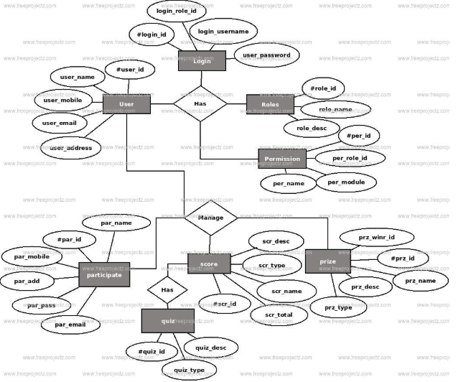
MINI PROJECT(APPLICATION DEVELOPMENT USING MYSQL) ONLINE QUIZ MANAGEMENT SYSTEM ER DIAGRAM

Slide 2
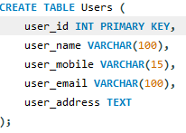


Table Creation Queries
1- User Table
Entering Data into Users
Output

Slide 3
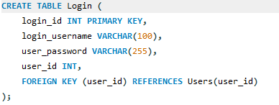


Login Table
Creating table
Inserting data
Output

Slide 4
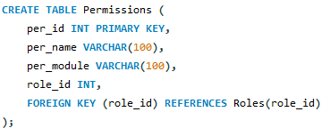


Permission Table
Creating table
Inserting data
Output

Slide 5
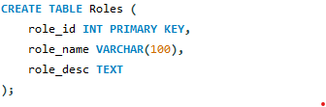



Roles Table
Creating table
Inserting Data
Retrieve Permissions for a Role

Slide 6
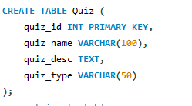


Quiz Table
Creating table
Inserting data
output

Slide 7
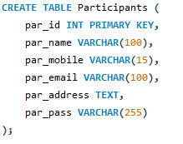



Participants Table
Creating table
Inserting table
Retrieve participants and their scores

Slide 8
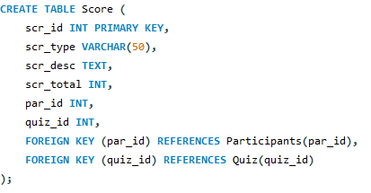


Score Table
Creating table
Inserting data
Output

Slide 9
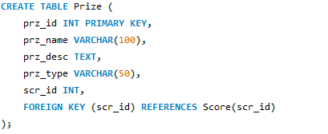



Prize Table
Creating table
Inserting data
Retreive Prize details based on scores

Slide 10


Updating Queries
Participants
Quiz

Slide 11


Join Queries
Join Users and Login
Output

Slide 12


Join Participants and Quizzes
Output
Query

